Slide 1
Secure Software Development Lifecycle
Software Exploitation

Slide 2
Learning Outcomes
Upon completion of this lesson, students will be able to:
Apply concepts of security to software development
Evaluate current workflows to determine what can be done to increase security

Slide 3
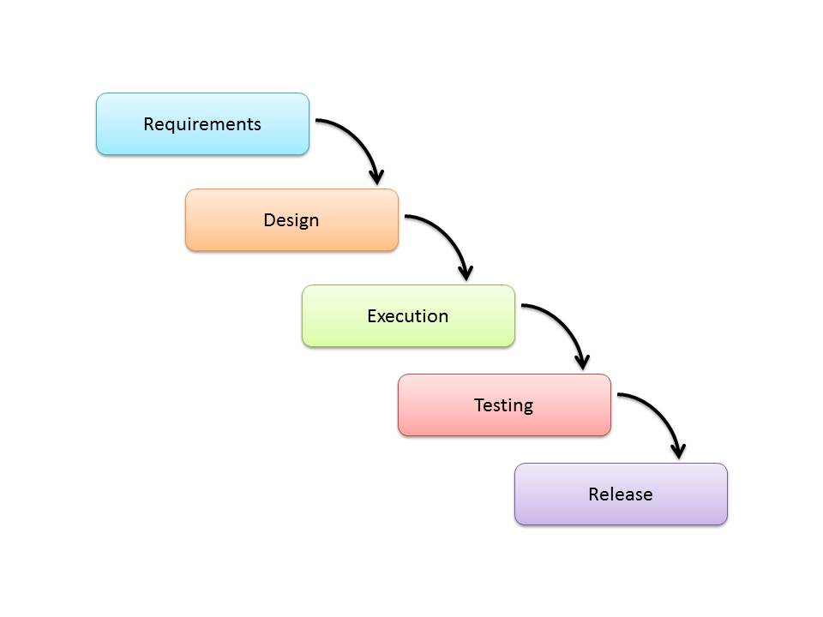
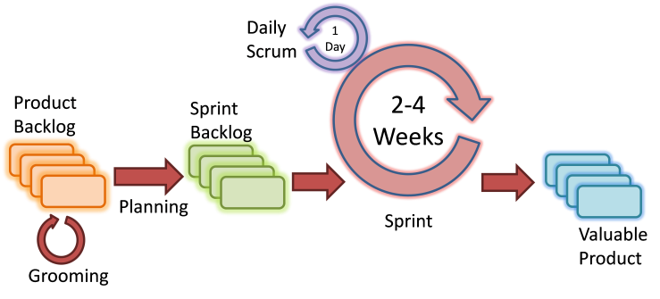
Software Development Lifecycle Refresher
A software development lifecycle describes the paths a piece of software will undergo while it’s in development
This is to create a more streamlined application because these methods have been tested and proven many times
There are many methods out there such as the waterfall and agile method each with their own advantages, but all of them can be modified to build security into an application
Waterfall: Agile:

Slide 4
Why Develop with Security In Mind?
This may be an obvious answer to some, but some software developers are not taught in depth security concepts
Security has mostly been implemented in the testing phases of development essentially as an afterthought. This often led to more holes left open than patched.
It’s much more effective to discover vulnerabilities through every stage of the process
Simply being constantly aware of secure concepts during development can lead to more secure applications
The need for more secure software led to the creation of the Secure SDLC (Software Development Lifecycle)

Slide 5
Benefits of the Secure SDLC
Some of these were mentioned before, but this is a clearer list:
Security being a constant part of development leads to more secure software
Vulnerabilities can be caught early and consistently
Friendlier on the budget due to early detection making maintenance and bug fixing shorter and easier
Less cost to resolve damages later on
More secure software is far less risky for a business to release

Slide 6
How is this done?
Existing models can be used with security principals listed in the requirement creation phase or…
A new model can be used. Below are a few:
OWASP’s CLASP – CLASP was built to integrate with existing processes, and focuses on easy integration to the existing workflow of all departments (https://www.owasp.org/index.php/CLASP_Concepts)
Microsoft’s SDL – Keeps the same steps of typical lifecycles, but describes what can be done at each stage to increase security. (https://www.microsoft.com/en-us/sdl/default.aspx)
US-CERT’s Secure SDLC Process Survey – This is a paper produced by the U.S. Computer Emergency Readiness Team (A division of Homeland Security). Although it may not be a “model” it dives into many different methodologies and will help in choosing the processes best for the team and project at hand.

Slide 7
Where to Begin
Most places have established their own process, so there are a few steps to maintain that but increase the level of security.
Here are some points for developers and testers:
Education is key, training developers more secure coding practices and secure frameworks should be the first step
Use code scanning tools (see the module on “open-source code scanning tools”)
Security should be included in test cases
Extending past the coders to administration and management:
To get things started quickly, help from specialized security companies can be handy
An effectiveness assessment of existing processes within the organization can help determine where work needs to be done to amplify the impact of secure practices

Slide 8
Summary
Security integrated into the software development lifecycle will yield a far more secure application than leaving it for the testing phases alone
There are many ways to implement secure practices into existing workflows, but new lifecycles have also been developed
Security should not be an afterthought, but rather a requirement from the beginning

